Slide 1
Fort Novosel
Directorate of Human Resources
Military Personnel Division

Slide 2
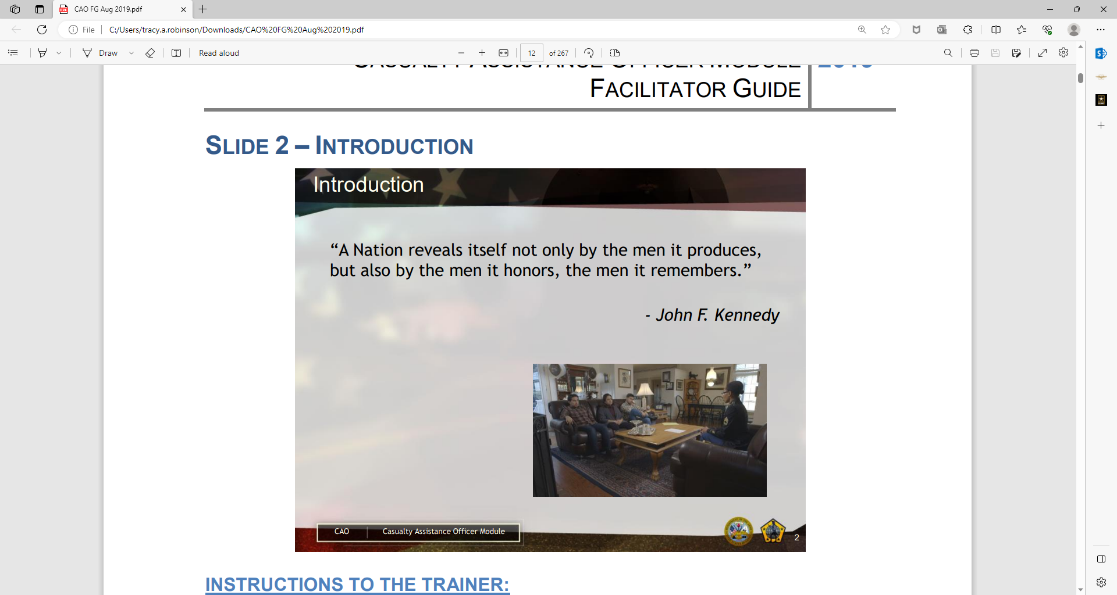
Introduction
  “A nation reveals itself not only by the men it produces, but also by the men it honors, the men it remembers.”
  - John F. Kennedy

Slide 3
Casualty Assistance Center
Mission
The primary mission of the Casualty Assistance Center is to provide high quality, quick and responsive, professional service to the primary next of kin (PNOK) of critically injured or deceased Active-Duty Army Soldiers, Retirees, Veterans and Department of the Army Civilians within our geographical area of responsibility.

Slide 4
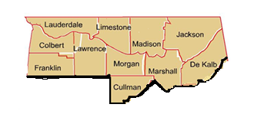
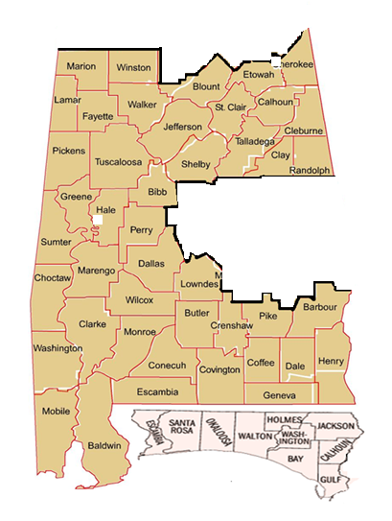
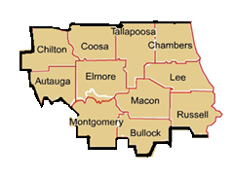
Fort Novosel Casualty Area of Responsibility
FORT MOORE
AOR
REDSTONE ARSENAL
AOR
7th SFG provides both CNO/CAO for their Soldiers
FORT NOVOSEL
AOR
Notes:
Once a casualty incident is confirmed, the military has the duty of notifying the Family involved. When a Soldier has died, a casualty notification officer visits the primary and secondary next of kin to notify the Family. In the case of an injured Soldier, notification depends on the nature of the Soldier’s injury. Generally for VSI or SI, the rear detachment command or CAC will notify the primary next of kin by telephone. Sometimes, a physician may contact the Family. When it is not a serious injury, the PNOK is notified by telephone if the illness or injury is a result of hostile action. In these cases, the Soldier generally notifies his/her Family.

Slide 5
Casualty Assistance Staff
Mr. Tracy A. Robinson
US ARMY GARRISON FT. NOVOSEL, AL
SUPERVISORY CASUALTY AFFAIRS COORDINATOR
Sarah M. Kelsey
US ARMY GARRISON FT. NOVOSEL
CASUALTY OPERATIONS COORDINATOR
ROBERT J. TAYLOR
US ARMY GARRISON FT.
NOVOSEL
MEMORIAL AFFAIRS COORDINATOR
Jerry L. Lucas
US ARMY GARRISON FT.
NOVOSEL
BENEFITS COORDINATOR
April D. Dardy
US ARMY GARRISON FT. NOVOSEL
MORTUARY AFFAIRS COORDINATOR
Terry L. Johnson
US ARMY GARRISON FT. NOVOSEL
TRAINING INSTRUCTOR (CASUALTY AFFAIRS)
Notes:
Good Morning
I am ______________from the Casualty Assistance Center I am the Training Instructor for the Fort Rucker CAC.
This morning I will give you a brief overview of the Casualty Notification Process.

Slide 6
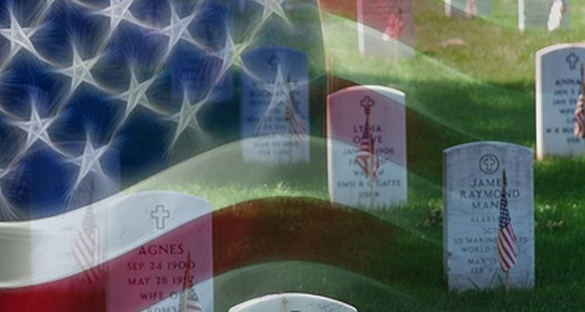
Your Military Retiree Federal Benefits
Notes:
Once a casualty incident is confirmed, the military has the duty of notifying the Family involved. When a Soldier has died, a casualty notification officer visits the primary and secondary next of kin to notify the Family. In the case of an injured Soldier, notification depends on the nature of the Soldier’s injury. Generally for VSI or SI, the rear detachment command or CAC will notify the primary next of kin by telephone. Sometimes, a physician may contact the Family. When it is not a serious injury, the PNOK is notified by telephone if the illness or injury is a result of hostile action. In these cases, the Soldier generally notifies his/her Family.

Slide 7
Defense Finance and Accounting Service (DFAS)
Contact DFAS to report the retiree's death and stop their retirement pay within the first couple of days. Retiree checks are paid in arrears, meaning on the 1st of each month for the prior month's pay. DFAS will take back the last retiree check sent if it is the month they passed or later. The Spouse/Surviving Next of Kin will have to apply to receive a prorated check for the month of the retiree's death.

Slide 8
Defense Finance and Accounting Service (DFAS)
SF 1174 - CLAIM FOR UNPAID COMPENSATION OF DECEASED MEMBER OF THE UNIFORMED SERVICES
Used to apply for the final prorated check. DFAS will mail this form to the survivor approximately 45 days after reporting the death. A complete packet includes SF 117 4 Claim for Unpaid Compensation of a Deceased Member of the Uniformed Services and a copy of the death certificate. The Casualty Assistance Center can assist the family to properly fill out this document and file the application, as needed.
Notes:
Before we can discuss what CARE Teams do, it is important to have some basic knowledge about casualties and casualty procedures.
According to Army Regulation 600-8-1, a casualty is any person lost to the organization by reason of having been declared beleaguered, besieged, captured, dead, diseased, detained, Duty Status Whereabouts Unknown, injured, ill, interned, missing, missing in action or wounded. Battalion commanders may activate Family CARE Teams to assist a Family when a Soldier is critically wounded or killed.
(Some additional points of explanation to make:)
Very seriously injured or ill (VSI) – severe illness or injury that life is endangered
Seriously injured or ill (SI) – severe illness or injury, but life is not endangered
Not seriously injured (NSI) – illness or injury may or may not require hospitalization, and Soldier can communicate with Family.

Slide 9
Survivor Benefit Plan
DFAS can confirm if the retiree was enrolled into this plan, as well as the plan chosen. If DFAS confirms enrollment into the SBP, they will mail the paperwork needed to the Survivor approximately 45 days after reporting the death. A complete packet includes a DD 2656-7 Verification of Survivor Annuity, W-4P Withholding Certificate for Pension or Annuity Payments, FMS 2231 Direct Deposit Fast Start, and a copy of the death certificate. The Casualty Assistance Center can assist the family to properly fill out this document and file the application, as needed.
Notes:
These are the individuals and agencies designated to respond when Soldier injury and death occur. It is important for CARE Teams to have an understanding of these individuals and agencies’ roles in assisting Families of casualties because they are likely to be present when you are at a Family’s home. It is also important not to overstep on these individual’s roles.
CAO - The CAO is a Soldier assigned by the CAC to provide support to the Family and aid with personnel-related matters. The CAO calls within 4 hours of official notification (but not between 10 pm and 6 am) to schedule visit with Family. The purpose of the first visit is to identify the Family’s needs and offer solace. In subsequent visits, the CAO offers counsel and support to Families on burial arrangements, benefits, and other personnel matters. The CAO’s role is to serve as ongoing resource for the Family. A CAO is relieved of other duties so that the CAO can assist for as long as is necessary for the Family to complete the transition (or to ensure the Family is receiving benefits and entitlements). Note: A CAO is sent when a Soldier has died or is missing.
Chaplain – The role of a military Chaplain is to accompany CNO when notification made in person. The Chaplain offers pastoral counseling, comfort and solace to Families of both wounded and fallen warriors.
Unit Commander/RDC – Leadership are responsible for coordinating support and identifying resources needed by Families and maintaining communication with Family. Leadership also oversee unit memorial service and CARE Teams.
Public Affairs Officer (PAO) – A Public Affairs Officer may contact the Family to offer information and guidance on dealing with the media.
Medical Family Assistance Center (MEDFAC) - In the event of a mass casualty, a Medical Family Assistance Center (MEDFAC) may be set up on an adhoc basis when high number of wounded, mass casualty, natural disaster, or terrorist attack. The MEDFAC provides information and support services to Families of Soldiers in military medical facilities.
Family Assistance Center (FAC) - In times of large scale mobilization, natural disaster, mass casualty, or other situations requiring activation, the FAC provides a base of broad support to the Family. The FAC becomes a point to coordinate available resources.

Slide 10
Reportable Casualties
and MFH
Retiree deaths are reportable to the department of the Army.
If a family requests military funeral honors, then the Casualty Assistance Center will complete the process at that time.
If there is a delay in requesting honors, or the family chooses not to have honors during the funeral, contact the Casualty Assistance Center to report the death.
US Army Fort Novosel, AL· 334-255-9005 or 334-255-9081
Notes:
These are the individuals and agencies designated to respond when Soldier injury and death occur. It is important for CARE Teams to have an understanding of these individuals and agencies’ roles in assisting Families of casualties because they are likely to be present when you are at a Family’s home. It is also important not to overstep on these individual’s roles.
CAO - The CAO is a Soldier assigned by the CAC to provide support to the Family and aid with personnel-related matters. The CAO calls within 4 hours of official notification (but not between 10 pm and 6 am) to schedule visit with Family. The purpose of the first visit is to identify the Family’s needs and offer solace. In subsequent visits, the CAO offers counsel and support to Families on burial arrangements, benefits, and other personnel matters. The CAO’s role is to serve as ongoing resource for the Family. A CAO is relieved of other duties so that the CAO can assist for as long as is necessary for the Family to complete the transition (or to ensure the Family is receiving benefits and entitlements). Note: A CAO is sent when a Soldier has died or is missing.
Chaplain – The role of a military Chaplain is to accompany CNO when notification made in person. The Chaplain offers pastoral counseling, comfort and solace to Families of both wounded and fallen warriors.
Unit Commander/RDC – Leadership are responsible for coordinating support and identifying resources needed by Families and maintaining communication with Family. Leadership also oversee unit memorial service and CARE Teams.
Public Affairs Officer (PAO) – A Public Affairs Officer may contact the Family to offer information and guidance on dealing with the media.
Medical Family Assistance Center (MEDFAC) - In the event of a mass casualty, a Medical Family Assistance Center (MEDFAC) may be set up on an adhoc basis when high number of wounded, mass casualty, natural disaster, or terrorist attack. The MEDFAC provides information and support services to Families of Soldiers in military medical facilities.
Family Assistance Center (FAC) - In times of large scale mobilization, natural disaster, mass casualty, or other situations requiring activation, the FAC provides a base of broad support to the Family. The FAC becomes a point to coordinate available resources.

Slide 11
Veterans Administration (VA)
Contact Local VA Office or 800-827-1000
Contact the VA to report the retiree death, whether they are receiving disability compensation.
The VA will be able to provide information on other benefits the family may be entitled to if eligible.
Benefits may include but are not limited to:
Dependency Indemnity Compensation -a tax free monthly benefit paid to a surviving spouse; awarded to spouses in a service-connected death.
Life Insurance - check with the VA for any Veteran's Group Life Insurance or other VA Life Insurance Program at 800-419-1473 and 800-669-8477
Thresholds are established by law.
Notes:
AER Assistance
Bibliotherapy
Grief/Bereavement Counseling resources, Chaplains, MFLCs, Behavioral Health and off post services.

Slide 12
Benefits may include but are not limited to: (Continued)
Burial and Plot Interment Allowance - flat rate monetary benefit paid to help cover burial and funeral costs. Amounts vary depending on whether the death is ruled as service connected.
For burial or cremation, benefits will vary depending on if the cemetery is private or national.
Survivors Pension - a monthly benefit paid to eligible survivors based on family income and the number of dependent children.
Thresholds are established by law.
Notes:
AER Assistance
Bibliotherapy
Grief/Bereavement Counseling resources, Chaplains, MFLCs, Behavioral Health and off post services.

Slide 13
Social Security Administration Contact the SSA to inquire to report the death and inquire about any changes, etc. The surviving spouse's benefit(s) may change depending on their status in the Social Security Administration's system. 1-800-772-1213
ID Card - Upon a retiree's death, ID cards will need to be reissued to those dependents who remain eligible due to the status change in DEERS no matter when the cards were issued. Contact the ID CARD/DEERS section to schedule an appointment.
Military - DEERS https://idco.dmdc.osd.mil/idco/
Tricare - Once new ID cards have been issued for dependents, contact Tricare or Tricare for Life for an explanation of status changes within the TRICARE system. Tricare1-800-444-5445 or Tricare for Life: 1-866-773-0404
Notes:
AER Assistance
Bibliotherapy
Grief/Bereavement Counseling resources, Chaplains, MFLCs, Behavioral Health and off post services.

Slide 14
  “There is no more effective way of creating bitter enemies for the Army than by failing to do everything we can possibly do at a time of bereavement. Nor is there a more effective way of making friends for the Army than by showing we are personally interested in every fatality which occurs.”
  - General George C. Marshall
Conclusion
Notes:
Good Morning
I am ______________from the Casualty Assistance Center I am the Training Instructor for the Fort Rucker CAC.
This morning I will give you a brief overview of the Casualty Notification Process.

Slide 15
LOCATION
CASUALTY ASSISTANCE CENTER
BLDG 5700, Room 185
Chief, Casualty Assistance Center
Mr. Tracy A. Robinson
PHONE NUMBERS: 334-255-9081/9311
EMAIL: usarmy.novosel.usag.mbx.casualty@army.mil
Notes:
These are the individuals and agencies designated to respond when Soldier injury and death occur. It is important for CARE Teams to have an understanding of these individuals and agencies’ roles in assisting Families of casualties because they are likely to be present when you are at a Family’s home. It is also important not to overstep on these individual’s roles.
CAO - The CAO is a Soldier assigned by the CAC to provide support to the Family and aid with personnel-related matters. The CAO calls within 4 hours of official notification (but not between 10 pm and 6 am) to schedule visit with Family. The purpose of the first visit is to identify the Family’s needs and offer solace. In subsequent visits, the CAO offers counsel and support to Families on burial arrangements, benefits, and other personnel matters. The CAO’s role is to serve as ongoing resource for the Family. A CAO is relieved of other duties so that the CAO can assist for as long as is necessary for the Family to complete the transition (or to ensure the Family is receiving benefits and entitlements). Note: A CAO is sent when a Soldier has died or is missing.
Chaplain – The role of a military Chaplain is to accompany CNO when notification made in person. The Chaplain offers pastoral counseling, comfort and solace to Families of both wounded and fallen warriors.
Unit Commander/RDC – Leadership are responsible for coordinating support and identifying resources needed by Families and maintaining communication with Family. Leadership also oversee unit memorial service and CARE Teams.
Public Affairs Officer (PAO) – A Public Affairs Officer may contact the Family to offer information and guidance on dealing with the media.
Medical Family Assistance Center (MEDFAC) - In the event of a mass casualty, a Medical Family Assistance Center (MEDFAC) may be set up on an adhoc basis when high number of wounded, mass casualty, natural disaster, or terrorist attack. The MEDFAC provides information and support services to Families of Soldiers in military medical facilities.
Family Assistance Center (FAC) - In times of large scale mobilization, natural disaster, mass casualty, or other situations requiring activation, the FAC provides a base of broad support to the Family. The FAC becomes a point to coordinate available resources.

Slide 16


